Slide 1


STUDENT MANAGEMENT SYSTEM
SIMRAN TATKARE-207014
29-10-2024

Slide 2
TOPICS TO DISCUSS
01
03
CODE & OUTPUT
INTRODUCTION
04
02
CONCLUSION
TECHNOLOGY USED

Slide 3

01
INTRODUCTION
The Student Management System is a Python-based, command-line application designed to manage student profiles efficiently.
This system allows users to create, access, and update student information securely, focusing on simplicity and ease of use.
The primary purpose of this system is to streamline common tasks involved in managing student data, such as registration, profile access, data updates, and secure logins.
Each student receives a unique ID, which helps maintain organized records.

Slide 4



02
TECHNOLOGIES USED ARE:
PYTHON
SQLITE
OOP

Slide 5

A.
PYTHON is a high-level, versatile programming language that’s widely used in various fields, from web development to data science, automation, artificial intelligence, and more.
Python is used for writing all functionalities, including data storage, user input handling, and implementing logic for registration, login, and profile management.
Dictionaries store student records in memory, with each student assigned a unique ID for easy access.

Slide 6
B.
SQLite is a lightweight, serverless, and self-contained relational database management system (RDBMS).
SQLite doesn’t require a separate server process to operate, making it ideal for embedded database usage in applications.
It stores the entire database as a single file on disk, making it portable and easy to set up.

Slide 7
c.
Class Structure:
The system uses an StudentManagementSystem class to group related methods and student data
Encapsulation:
Each method within the class handles a specific function allowing for clear separation of tasks and maintainability

Slide 8
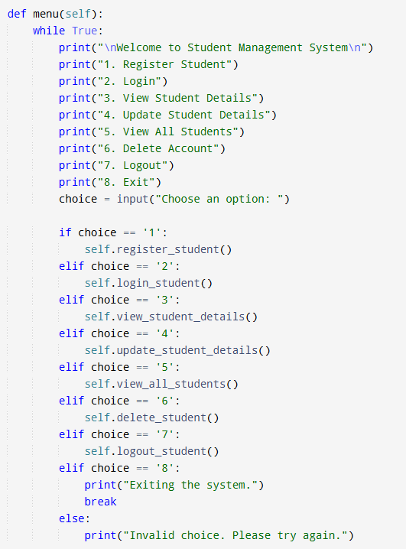
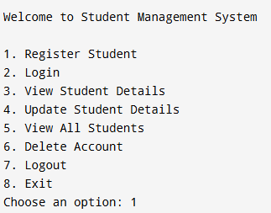
03
C
O
D
E
OUTPUT

Slide 9
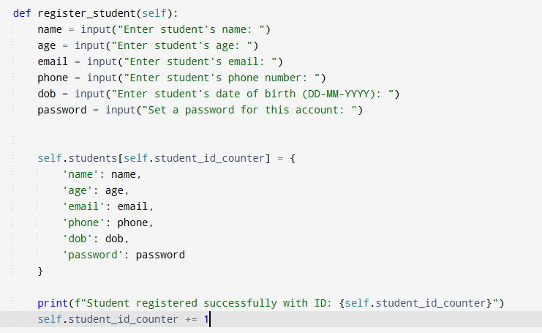
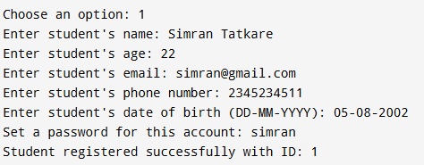
CODE
OUTPUT

Slide 10
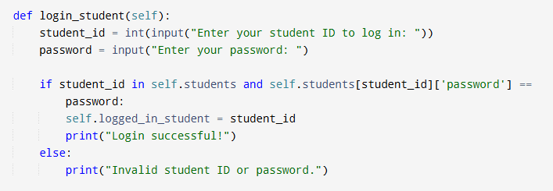
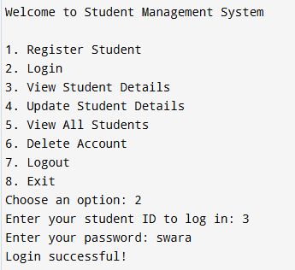
CODE
OUTPUT

Slide 11
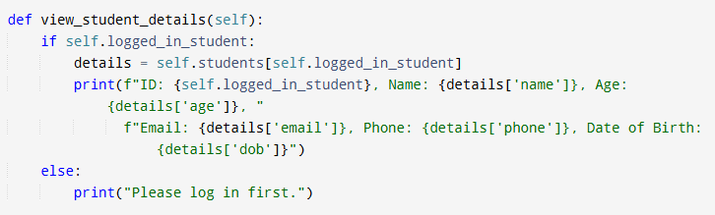
CODE
OUTPUT

Slide 12
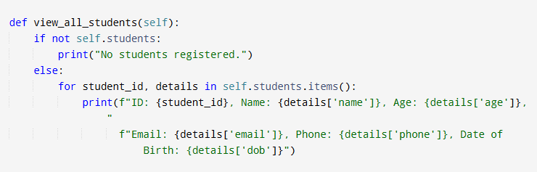
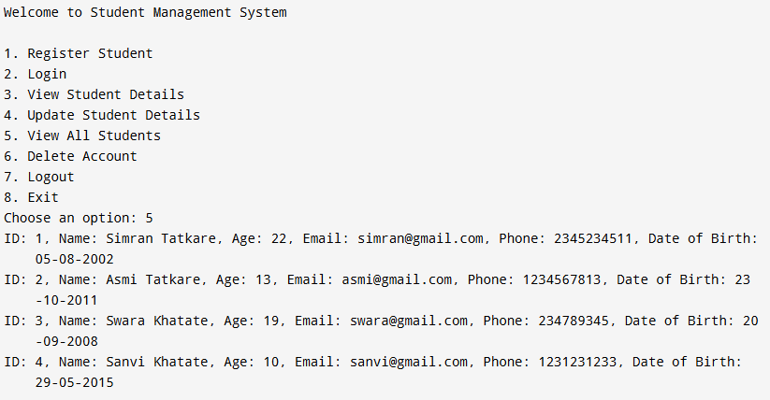
CODE
OUTPUT

Slide 13
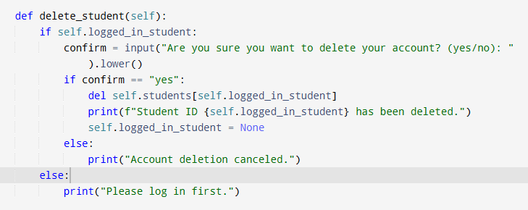
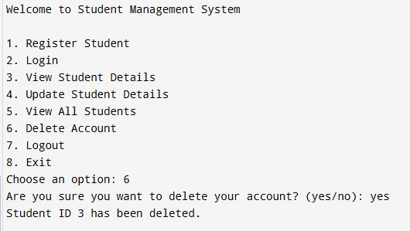
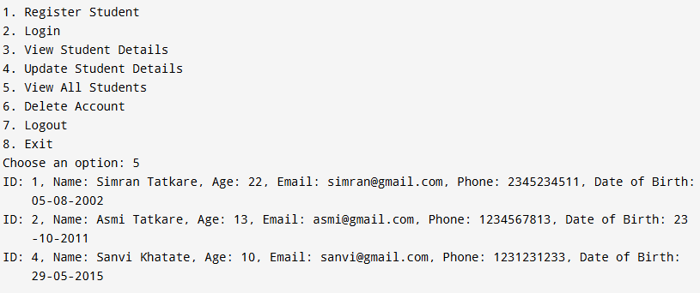
CODE
OUTPUT

Slide 14
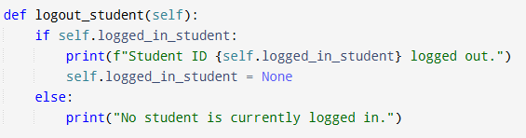
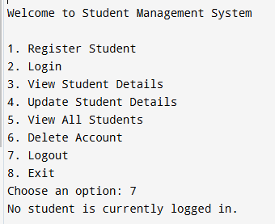
CODE
OUTPUT

Slide 15
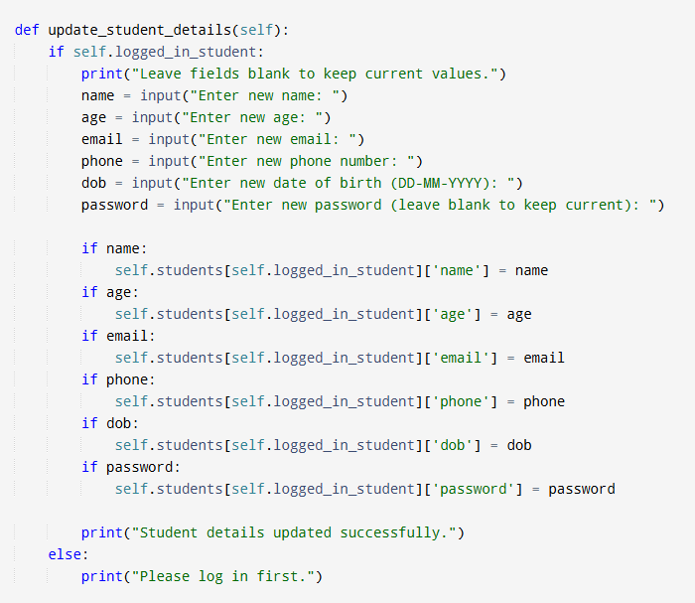
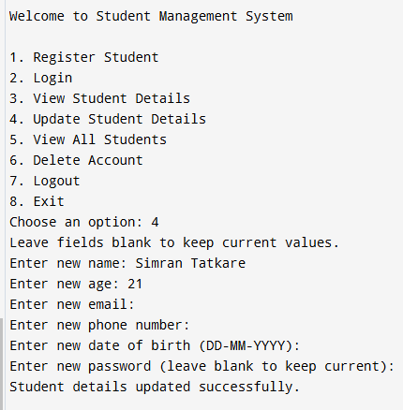
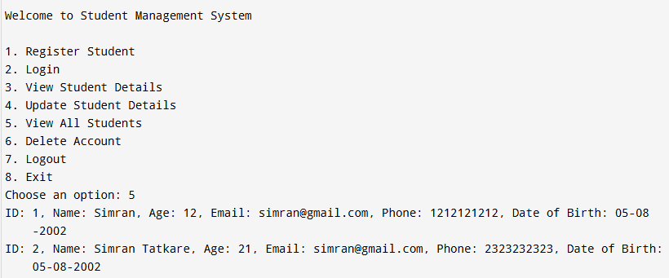
CODE
OUTPUT

Slide 16
CONCLUSION
The Student Management System project provides an efficient way to manage student information.
Offering features like registration, login, profile updates, account deletion, and viewing details.
Future improvements could include adding database integration and admin features, making it even more robust and adaptable for real-world use

Slide 17

THANK YOU!

